Slide 1



Chapter 11
Experimental
Design with
More Than Two
Levels of an
Independent
Variable
@ 2012 Wadsworth, Cengage Learning

Slide 2
Topics
Using Designs with More Than Two Levels of an Independent Variable
Analyzing the Multiple-Group Experiment Using Parametric Statistics
Nonparametric Statistics for the Multiple-Group Experiment

Slide 3
Using Designs with More Than Two Levels of an Independent Variable

Slide 4
Using Designs with More Than Two Levels of an Independent Variable
Three reasons:
  Allows researchers to compare multiple treatments
  Enables them to compare multiple treatments with no treatment
  More complex designs allow researchers to compare a placebo group with control and experimental groups (Mitchell & Jolley, 2004)

Slide 5
Using Designs with
More Than Two Levels (cont’d.)
Bonferroni adjustment: setting a more stringent alpha level for multiple tests to minimize Type I errors
Another advantage of comparing more than two kinds of treatment in one experiment:
  Reduces both:
    The number of experiments conducted
    The number of participants needed

Slide 6
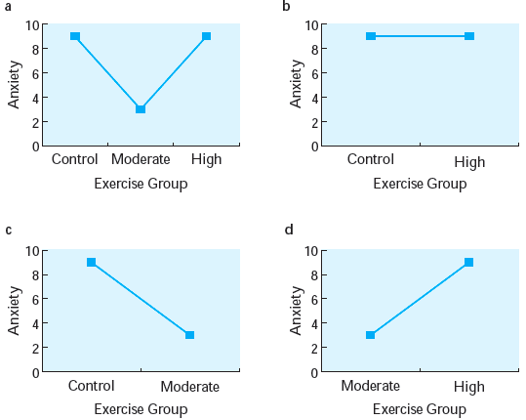
Figure 11.1 Determining relationships with three-group versus two-group designs:
three-group design;
two-group comparison of control to high aerobic activity;
two-group comparison of control to moderate aerobic activity;
two-group comparison of moderate aerobic activity to high aerobic activity

Slide 7
Using Designs with
More Than Two Levels (cont’d.)
How can adding a placebo group improve an experiment?
  Allows for a more accurate assessment of a therapy’s effectiveness
    Spontaneous remission
    Controls for participant expectation effects

Slide 8
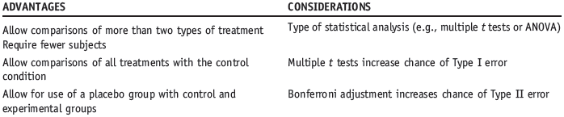
Using Designs with
More Than Two Levels (cont’d.)
Designs with More Than Two Levels of an Independent Variable

Slide 9
Analyzing the Multiple-Group Experiment Using Parametric Statistics

Slide 10
Analyzing the
Multiple-Group Experiment
ANOVA (analysis of variance): an inferential statistical test for comparing the means of three or more groups
One-way randomized ANOVA
  An inferential statistical test for comparing the means of three or more groups using:
    A between-subjects design and
    One independent variable

Slide 11
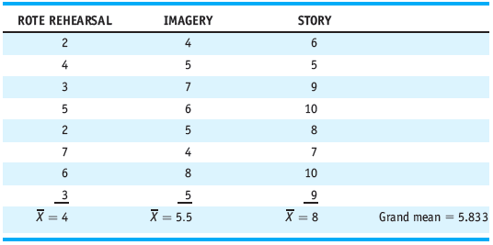
Analyzing the Multiple-Group Experiment (cont’d.)
Table 11.1 Numbers of Words Recalled Correctly in Rote Rehearsal, Imagery, and Story Conditions

Slide 12
Analyzing the Multiple-Group Experiment (cont’d.)
Grand mean: the mean performance across all participants in a study
Error variance: the amount of variability among the scores caused by chance or uncontrolled variables
Within-groups variance
  The variance within each condition
  An estimate of the population error variance

Slide 13
Analyzing the Multiple-Group Experiment (cont’d.)
Between-groups variance: an estimate of the effect of the independent variable and error variance
F-ratio: the ratio of between-groups variance to within-groups variance

Slide 14
Analyzing the Multiple-Group Experiment (cont’d.)
For an F-ratio to be significant
  It must be substantially greater than 1
If an F-ratio is approximately 1
  Then the between-groups variance equals the within-groups variance
  There is no effect of the independent variable
Total sum of squares: the sum of the squared deviations of each score from the grand mean

Slide 15
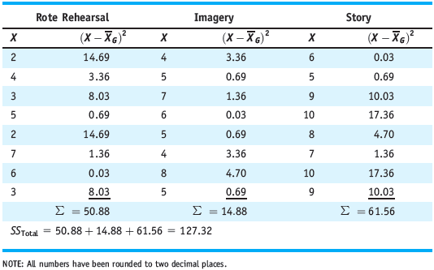
Analyzing the Multiple-Group Experiment (cont’d.)
Table 11.2 Calculation of SS_{Total} Using the Definitional Formula

Slide 16
Analyzing the Multiple-Group Experiment (cont’d.)
Within-groups sum of squares: the sum of the squared deviations of each score from its group mean
Between-groups sum of squares
  The sum of the squared deviations of each group’s mean from the grand mean, multiplied by the number of subjects in each group

Slide 17
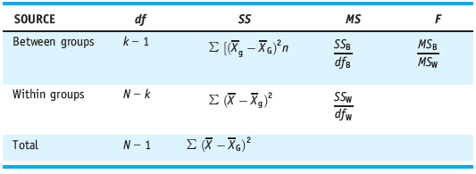
Analyzing the Multiple-Group Experiment (cont’d.)
Mean square: an estimate of either variance between groups or variance within groups
Table 11.5 ANOVA Summary Table: Definitional Formulas

Slide 18

Analyzing the Multiple-Group Experiment (cont’d.)
Eta-squared (η²)
  An inferential statistic for measuring effect size with an ANOVA
  Calculated as follows:

Slide 19
Analyzing the Multiple-Group Experiment (cont’d.)
Assumptions for the one-way randomized ANOVA:
  Data are on an interval-ratio scale
  Underlying distribution is normally distributed
  Variances among the populations being compared are homogeneous
  Observations are all independent of one another
Violations of some assumptions
  Do not necessarily affect the results

Slide 20
Analyzing the Multiple-Group Experiment (cont’d.)
Post hoc test
  When used with an ANOVA, a means of comparing all possible pairs of groups to determine which ones differ significantly from each other
Tukey’s honestly significant difference (HSD)
  A post hoc test used with ANOVA for making all pairwise comparisons when conditions have equal n’s

Slide 21

Analyzing the Multiple-Group Experiment (cont’d.)
Formula for Tukey’s HSD:
One-way repeated measures ANOVA
  An inferential statistical test for comparing the means of three or more groups using a correlated- groups design and one independent variable

Slide 22
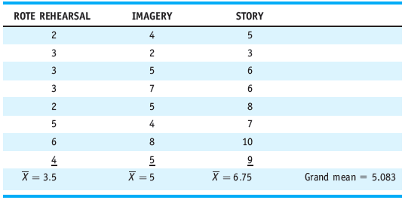
Analyzing the Multiple-Group Experiment (cont’d.)
Table 11.8 Numbers of Words Recalled in a Within-Subjects Study of the Effects of Rehearsal Type on Memory

Slide 23
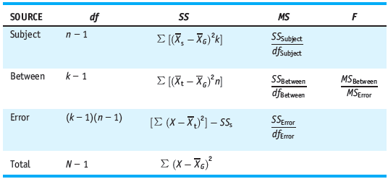
Analyzing the Multiple-Group Experiment (cont’d.)
Table 11.13 Repeated Measures ANOVA Summary Table: Definitional formulas

Slide 24
Analyzing the Multiple-Group Experiment (cont’d.)
Assumptions of the one-way repeated measures ANOVA
  The data are on an interval-ratio scale
  The underlying distribution is normally distributed
  The variances among the populations being compared are homogeneous
  The groups are correlated

Slide 25
Nonparametric Statistics for the Multiple-Group Experiment

Slide 26
Nonparametric Statistics for the Multiple-Group Experiment
Kruskal-Wallis test is appropriate
  When the data are ordinal or
  If the involved populations are not normally distributed
Analogous test for use with a within-subjects design: Friedman rank test

Slide 27
Summary
Advantages:
  Compare more than two kinds of treatment
  Use fewer participants
  Compare all treatments with a control group
  Use placebo groups
Randomized one-way ANOVA: used for between-subjects designs
Repeated measures one-way ANOVA: used for correlated-groups designs

